Slide 1
Securities Issuance & Distributions

Slide 2
Issuance & distributions
Issuance: stock, bonds, bank debt
Capital
Investors
Firm
Capital
Distributions: dividends, share repurchases, interest payments

Slide 3
Cap structure & issuance/distributions
Capital structure: Mix of equity and debt at a particular point in time (snapshot)
Determined by issuance and distribution decisions over time
E.G., a firm that never issues debt will have a very conservative capital structure
Issuance/distributions: Flow of capital into and out of a firm
Decisions should be made with an eye towards implications for capital structure
E.G., current leverage < target leverage => issue debt
Other factors may influence issuance/distribution decisions as well

Slide 4
Issuing securities
Public placement of stock or bonds
First equity issuance: IPO (initial public offering), subsequent equity issuances: SEOs (seasoned equity offerings)
New securities must be registered with the Securities & Exchange Commission (SEC)
Almost always underwritten by investment bank (more on the next slide)
Private placement of stock or bonds
Securities sold to investor at negotiated price
Equity typically sold at substantial discount to current price (often restrictions on trading, so holding is illiquid)
Rule 144A: Qualified institutions (>$100M in assets) allowed to trade among themselves

Slide 5
Underwriting issuances
Two standard underwriting arrangements:
Firm commitment offer: Underwriter (investment bank) effectively buys the shares from the company, resells to public
Underwriter keeps difference between selling price and price it pays company (7% for IPOs, 3% for SEOs, 1-2% for bonds)
Underwriter bears risk that issue does not sell
Best efforts offer (less common): Underwriter receives commission for selling shares (around 2%), does not take ownership of shares
Company bears risk that issue does not sell
Underwriter responsible for registering securities w/ SEC, marketing (e.g., “roadshow” for IPO), pricing (“bookbuilding” for IPO)

Slide 6
Securities & information
Company issues security, offers you the opportunity to buy it for $100
You conduct fundamental analysis, conclude value of security is $120
Assuming you have the capital and the security would be part of a well-diversified portfolio, should you buy it?
What if you found out that the company also offered some of the security to Warren Buffet and he declined?
What if you found out that management is selling its shares?
Not enough to conduct our own analysis, need to think about what information others might have

Slide 7
Markets & information
March 19, 2009: Discover announced quarterly dividend cut of 4 cents per share → stock price declined by 58 cents (-14.7% return)
Why would market respond so negatively to a dividend cut?
Dividend cut itself not value-destroying
If Discover used the 4 cents each quarter to invest in zero-NPV projects, no effect on Discover’s value
Perhaps dividend cut revealed weak earnings, inability to sustain current dividend
Market constantly trying to figure out what management knows based on company’s actions
Makes interpreting market’s response to corporate actions tricky

Slide 8
Interpreting announcement returns
A company’s stock price tends to drop on the announcement that the board of directors is firing the CEO
One interpretation: Investors think that outgoing CEO was good, expect incoming CEO to be worse on average
Alternative interpretation: Firing of CEO reveals problems with the company market was not previously aware of
Negative announcement return does not necessarily imply that company is taking an action that harms shareholders

Slide 9
Interpreting announcement returns
A company’s stock price often drops on the announcement that it is acquiring another company
One interpretation: Investors think that the company is overpaying for the acquisition
Alternative interpretation: Acquisition reveals that company’s internal investment opportunities are worse than investors anticipated
Negative announcement return does not necessarily imply that company is taking an action that harms shareholders

Slide 10
Interpreting announcement returns
A company’s stock price tends to rise on the announcement of increase in dividends
One interpretation: Investors think company is wasting money, increasing dividend will curb wasteful investment
Alternative interpretation: Increasing investment reveals company has strong future cash flow, can afford higher dividend payment
Market may respond positively to dividend announcement even if paying higher dividend means company possibly has to forgo positive NPV investments in future
Positive announcement return does not necessarily imply that company is taking an action that benefits shareholders

Slide 11
The lemons problem
Concerns about informational disadvantage can disrupt markets
Suppose somebody offers to sell you a car
Car might be high quality or a “lemon,” each w/ 50% probability
High quality car worth $50,000 to you, only $40,000 to seller
Lemon worth $20,000 to you, $16,000 to seller
Gains from trade: Regardless of which type of car, you get more value from the car than the seller
Suppose seller has been driving car, knows whether it is high-quality or a lemon
How much are you willing to pay for the car?

Slide 12
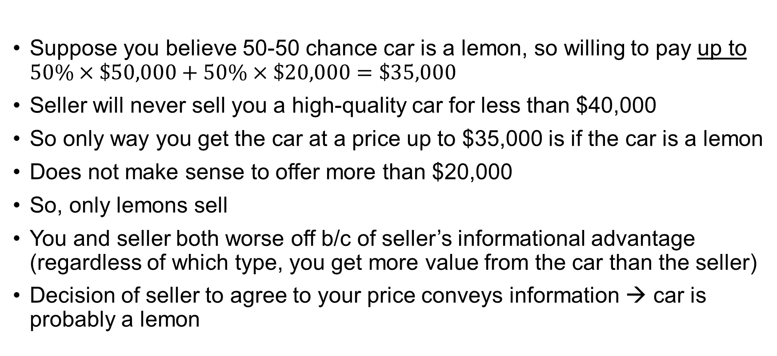
The lemons problem
Your valuation: $20K or $50K | Seller’s valuation: $16K or $40K
Suppose you believe 50-50 chance car is a lemon, so willing to pay up to $50\%×\$50,000+50\%×\$20,000=\$35,000$
Seller will never sell you a high-quality car for less than $40,000
So only way you get the car at a price up to $35,000 is if the car is a lemon
Does not make sense to offer more than $20,000
So, only lemons sell
You and seller both worse off b/c of seller’s informational advantage (regardless of which type, you get more value from the car than the seller)
Decision of seller to agree to your price conveys information → car is probably a lemon

Slide 13
The lemons problem & unravelling
Lemons problem can cause a market to unravel
Suppose you (buyer) believe value is somewhere along a continuum from A to B and seller knows the value
A
B
If you were to offer average value (somewhere between A & B), seller only willing to sell if actual value below a threshold value less than B (say, C)
A
C
B
But then it would only make sense to offer a price somewhere between A & C (say, D)
If you were to offer updated average value (somewhere between A & C), seller only willing to sell if actual value below a threshold less than C (say, D)
A
D
C
B
Etc.

Slide 14
Solving the lemons problem
The lemons problem is costly for everyone involved
Car more valuable to you, but seller’s informational advantage means you may not be able to agree on a price if car is high-quality
Solution?
One solution: Seller includes a warranty
Covers costs of repairs
Full warranty may create too much moral hazard (buyer might drive car aggressively if seller is paying for 100% of repairs)
Even partial warranty may “signal” car’s quality

Slide 15
Signaling
Suppose you are recruiting spies for the CIA
One very important characteristics of a good spy: Ability to withstand torture (i.e., high pain tolerance)
Two candidates apply for the job
You give each candidate a pair of scissors and ask the candidate to cut off a finger
Candidate A refuses
Candidate B slowly cuts off a finger in front of you
Which candidate do you want to hire?

Slide 16
Signaling
If ability to withstand torture is a crucial characteristic of a good spy, then you probably want to hire Candidate B
Cutting off a finger credibly signals Candidate B’s high pain threshold
Costly signaling: For a signal to be useful in transmitting information (i.e., credible), it must be
More costly for the “wrong” type of individual to send than for the “right” type (actions speak louder than words)
Cutting off a finger is costly for anyone, but it is more costly for a low pain threshold candidate (the wrong type) than for a high pain threshold candidate (the right type)
Offering car warranty costly, more costly if car is actually a lemon (the wrong type) than if it is high quality (the right type)

Slide 17
Going public
Suppose you are an entrepreneur and are about to take your company public
How can you signal to the market that your company is not a lemon?
Retaining a large stake in the company can be a credible signal
Retaining large stake costly b/c you cannot diversify your portfolio
Retaining large stake more costly for the wrong type of entrepreneur (one with a lemon) b/c the value of the stake will end up being low
Might also use a highly-reputable underwriter to signal firm quality

Slide 18
Securities issuance
Tradeoff framework suggests having a target capital structure
Target capital structure should influence decisions about what securities to issue when raising capital
But information is also an important factor
In practice, companies are reluctant to issue equity
Reluctance makes sense: Average announcement return around seasoned equity offerings is -3.0% (25% of proceeds raised)
Negative market reaction could indicate investors believe management will waste money; alternative?
Alternative: Companies avoid issuing shares if they are undervalued, so equity issuance may indicate company is overvalued

Slide 19
Lemons problem in equity markets
Corporate management likely to have information relevant to company’s value that outside investors lack
Management does not want to issue equity when the equity is undervalued (“dilutes” existing shareholders)
Voluntary act of selling equity tells investors equity is likely to be overvalued (i.e., is bad news)
Not surprising that stock market generally reacts negatively to equity issuance announcement
Market accounts for information when pricing new issue, makes management even more reluctant to issue equity
Management may forgo even positive NPV projects rather than issue equity to finance them

Slide 20
Equity issuance & info example
An all-equity financed company has
Operating assets that will pay off either $100M or $180M next year, each w/ 50% probability
Investment opportunity that requires $100M investment today and pays off $110M next year w/ certainty
No discounting, so investment opportunity has NPV of $10M
Will the company invest in the project if it
Has cash on hand to finance the investment?
Plans to issue equity to finance investment and management does not know more than investors do about payoff of operating assets?
Plans to issue equity to finance investment and management knows payoff of operating assets?
Plans to issue debt to finance investment?

Slide 21
Equity issuance & info example
Operating Assets
50%
PV: $180M
Investment opportunity
$100M
PV: $110M
50%
PV: $100M
Suppose company has cash on hand to finance investment
Positive-NPV investment, so company invests
Shareholders realize full $10M NPV from investment

Slide 22
Equity issuance & info example
Operating Assets
50%
PV: $180M
Nobody knows which
Investment opportunity
$100M
PV: $110M
50%
PV: $100M
Suppose company lacks cash, must issue equity to finance investment
Suppose neither management nor investors know payoff from operating assets
Once funded, company is worth $140M + $110M = $250M
Sell 40% of the equity in the company in exchange for $100M; value of new equity = 40% x $250M = $100M
Value of existing shareholders’ claims w/ investment = 60% x $250M = $150M
Existing shareholders get $140M if no investment, so they capture $10M NPV from investment

Slide 23
Equity issuance & info example
Operating Assets
50%
PV: $180M
Only mgmt knows which
Investment opportunity
$100M
PV: $110M
50%
PV: $100M
Suppose company lacks cash, must issue equity to finance investment
Suppose management knows payoff from operating assets (and investors anticipate this)
Company offers you 40% of equity in exchange for $100M of capital to finance investment. Interested? How would you decide?
Note: 40% of avg company worth 40% x ($140M + $110M) = $100M

Slide 24
Equity issuance & info example
Operating Assets
50%
PV: $180M
Only mgmt knows which
Investment opportunity
$100M
PV: $110M
50%
PV: $100M
If operating assets yield CF of $180M, existing shareholders get
60% x ($180M + $110M) = $174M if company issues equity & invests
$180M if company does nothing
Company will not issue equity if operating assets worth $180M
Selling equity in that case would “dilute” shareholders
Management knows new equity would actually be worth 40% x ($180M + $110M) = $116M, not $100M
Benefit of investing: Create $10M of value
Cost of investing (dilution): Sell shares for $16M less than they are actually worth ($116M - $100M)
Cost outweighs benefit, so no investment

Slide 25
Equity issuance & info example
Operating Assets
50%
PV: $180M
Only mgmt knows which
Investment opportunity
$100M
PV: $110M
50%
PV: $100M
Suppose management knows operating assets pay off $100M; will it issue equity?
If you believe company selling equity must have operating assets that pay off $100M, you demand 100/210 = 45.7% of equity in exchange for $100M of capital
45.7% x ($100M + $110M) = $100M
So, existing shareholders retain at least 54.3% of equity, get at least 54.3% x ($100M + $110M) = $110M if company raises equity
Existing shareholders only get $100M if company does not raise equity, so company will raise equity if operating assets pay off $100M

Slide 26
Equity issuance & info example
Operating Assets
50%
PV: $180M
Only mgmt knows which
Investment opportunity
$100M
PV: $110M
50%
PV: $100M
So, now are you interested in buying 40% of the company’s equity for $100M?
Company will not issue equity if management knows operating assets will generate $180M of cash flow
Act of issuing equity reveals that management must know operating assets will generate only $100M of cash flow
So, 40% of equity is only worth 40% x ($100M + $110M) = $88M if company chooses to issue equity
You should price company under the assumption that operating assets worth $100M, so require 100/210 = 45.7% of equity for $100M

Slide 27
Equity issuance & info example
Operating Assets
50%
PV: $180M
Only mgmt knows which
Investment opportunity
$100M
PV: $110M
50%
PV: $100M
How will stock market respond to announcement that company is issuing equity to pursue this investment opportunity?
Assume 1M shares currently outstanding (the # does not matter)
Before announcement, market believes existing equity is worth $140M, so $140 per share
Assumes market does not know about investment opportunity; price would be a little higher if it knows about investment opportunity
After announcement, market believes existing equity is worth 54.3% x ($100M + $110M) = $110M, or $110 per share
So stock price will fall by $30 on announcement of equity issuance

Slide 28
Equity issuance & info example
Operating Assets
50%
PV: $180M
Only mgmt knows which
Investment opportunity
$100M
PV: $110M
50%
PV: $100M
Implications:
Investors should worry about lemons problem in equity market
Company may voluntarily turn down a positive NPV investment if it management has positive private information and company must issue equity in order to finance the investment
Issuing equity reveals management may have negative private information; market likely to respond negatively to equity issuance

Slide 29
Debt issuance?
Operating Assets
50%
PV: $180M
Only mgmt knows which
Investment opportunity
$100M
PV: $110M
50%
PV: $100M
What if company can finance investment by issuing debt instead of equity?
Debt is risk-free (minimum cash flow after investing is $210M), so raise $100M by issuing debt w/ promised repayment of $100M
Existing shareholders capture $10M NPV

Slide 30
Information & debt vs. equity
Risk-free debt payoffs insensitive to information, so no lemons problem with risk-free debt
More generally, debt is typically less informationally-sensitive than equity, so lemons problem less severe w/ debt
Value of Equity
Value of Debt
Value of Assets
Value of Assets
Debt
Debt
Valuation sensitive to information
Valuation sensitive to information

Slide 31
Pecking order of financing
Retained earnings, if available
Risk-free debt, if possible
Risky debt
Equity
Why would a company ever issue equity?
Company may have limited “debt capacity,” can only borrow up to a certain amount before financial distress risk becomes too high

Slide 32
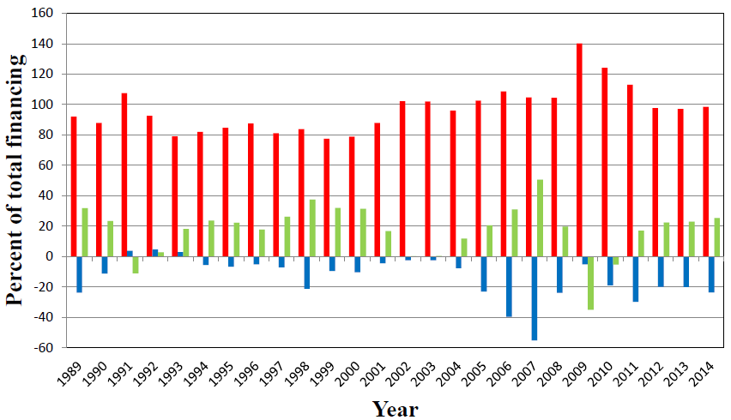
Sources of corporate financing
Internal Funds
New Equity
New Debt
Source: FED flow of funds

Slide 33
Sources of corporate financing

Slide 34
Dilution
In the example, investors undervalue equity if operating assets have high CF (b/c they do not observe this value)
Selling underpriced equity “dilutes” existing shareholders
Selling fairly priced equity does not dilute shareholders
If investing proceeds in positive NPV projects, existing shareholders are better off
If investing proceeds in zero NPV projects, existing shareholders no better or worse off

Slide 35
Dilution Example
Company has 1M shares outstanding, market value of $10M, so $10 per share
Company sells 1M new shares for $10 per share, invests proceeds in 0-NPV project
$10M invested in 0-NPV project: Project PV = $10M
Value of company after investment = $10M + $10M = $20M
Value per share = $20M / 2M shares = $10 per share
New investors getting shares at fair price
Existing shareholders no better or worse off (shares still worth $10)
If company sells new shares for more than $10, existing shareholders gain
If company sells new shares for less than $10, existing shareholders lose

Slide 36
Conclusions about cap structure
Sensible framework for thinking about capital structure
Firm should have target leverage ratios
Only adjust leverage through issuance/distribution when current leverage ratio deviates from target by some amount
Cost of adjusting asymmetric: Decreasing leverage can be very costly if requires issuing equity b/c of information problems
But cost of being too levered can also be higher if it causes debt overhang

Slide 37
Other informational concerns
We should worry that a company’s management knows something about company’s value that we do not when company decides to sell securities
We should also worry that other investors may know something we do not about company’s value when company sells securities
Suppose company sells shares in an IPO, and we are bidding against Warren Buffet for shares
We potentially face “winner’s curse” problem

Slide 38
Winner’s curse example
Company plans to sell 1M shares of stock in an IPO
Each share is worth either $10 or $20, each w/ 50% probability
We are willing to buy up to 1M shares as long as we at least break even
Warren Buffet is willing to buy up to 1M shares as long as he at least breaks even
Warren Buffet knows what a share is actually worth, we do not
Company (w/ its investment bankers) sets IPO price; we and Warren Buffet each decide how many shares to order at that price
If issue oversubscribed (orders exceed 1M shares), shares are rationed pro rata

Slide 39
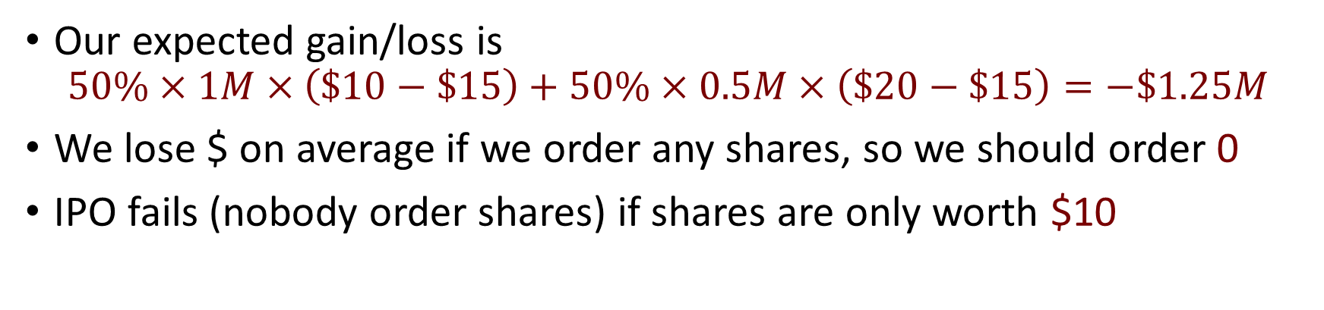
Winner’s curse example
Average value of share = 50% x $10 + 50% x $20 = $15
Suppose company sets price at $15 per share
Suppose we order 1M shares
Actual share value | Warrant Buffet orders | We receive
$10 | 0 shares | 1M shares
$20 | 1M shares | 0.5M shares
Our expected gain/loss is
$$50\%×1M×\left(\$10−\$15\right)+50\%×0.5M×\left(\$20−\$15\right)=−\$1.25M$$
We lose $ on average if we order any shares, so we should order 0
IPO fails (nobody order shares) if shares are only worth $10

Slide 40
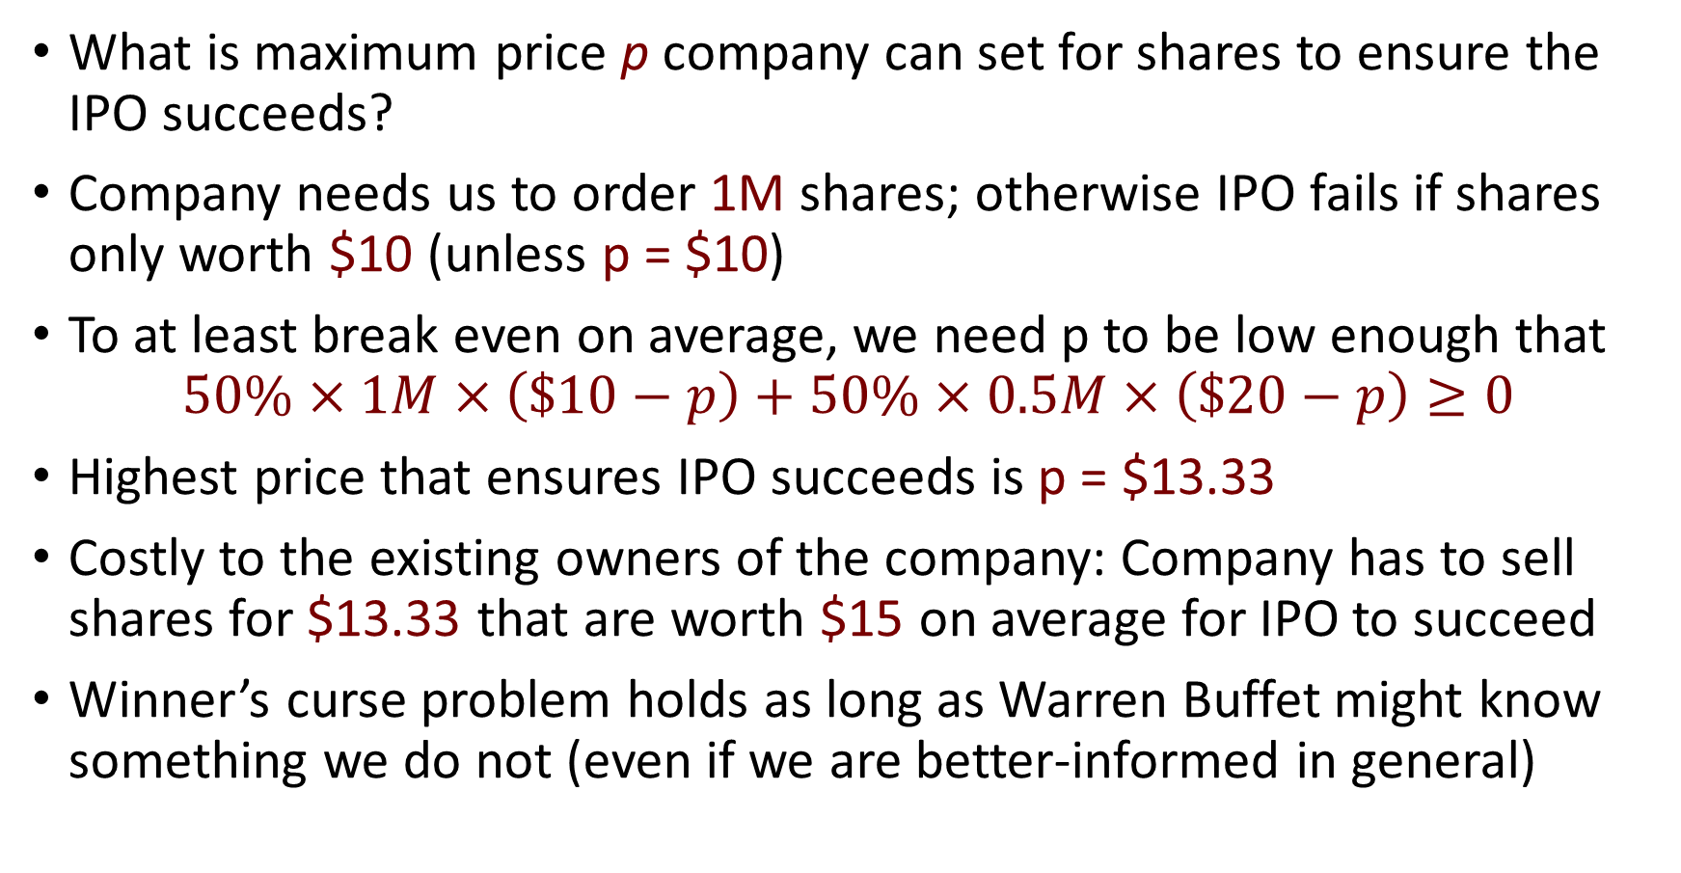
Winner’s curse example
What is maximum price p company can set for shares to ensure the IPO succeeds?
Company needs us to order 1M shares; otherwise IPO fails if shares only worth $10 (unless p = $10)
To at least break even on average, we need p to be low enough that
$$50\%×1M×\left(\$10−p\right)+50\%×0.5M×\left(\$20−p\right)≥0$$
Highest price that ensures IPO succeeds is p = $13.33
Costly to the existing owners of the company: Company has to sell shares for $13.33 that are worth $15 on average for IPO to succeed
Winner’s curse problem holds as long as Warren Buffet might know something we do not (even if we are better-informed in general)

Slide 41
Winner’s curse & IPO returns
Average first-day return after IPOs in practice is 15-20%
Why would existing owners “give away” so much value for free?
May be only way to attract investors who are worried about winner’s curse; may need those investors to subscribe for successful IPO
In the example, share price right after IPO is either $10 or $20, depending on whether Warren Buffet bought any shares
Average price right after IPO is 50% x $10 + 50% x $20 = $15
On average, share price in example rises by 12.5% (from $13.33 to $15) on the first day
Other explanations for first-day IPO returns: investment bankers’ incentives, publicity, concerns about lawsuits

Slide 42
Distributions to shareholders
Company can return excess cash to shareholders by paying dividends or repurchasing shares
Dividends: Shareholders of record as of ex-dividend date receive dividends
Stock price mechanically drops by amount of dividend on ex dividend date ($100 stock paying $5 dividend goes to $95 on ex dividend date)
Repurchases: Company buys shares back from investors
Open market repurchase: Buy shares on stock exchange
Tender offer: Repurchase at fixed price; shareholders choose to tender (sell)
Dutch auction: Shareholders indicate price at which they will tender; company determines lowest price at which it can buy the # of shares it wants, pays that price for all shares tendered at or below that price
Do shareholders prefer dividends or repurchases?

Slide 43
Dividends vs repurchase example
Company has 100M shares outstanding, operating assets worth $900M, cash of $100M (so worth $10 per share)
Company wants to pay out $100M cash to shareholders
No taxes
Dividend: Shareholder owns $1 cash + a share worth $9 ($10 in total)
Repurchase (buy back 10M shares at $10 per share, so 90M shares remain outstanding afterwards)
Shareholder sells share back: Receives $10 cash
Shareholder retains share: Owns share worth $900M/90M = $10
So, shareholders indifferent between dividend and share repurchase

Slide 44
Taxes & dividends vs repurchases
Repurchases generally tax advantaged vs paying dividends
U.S. dividend tax rate: 15-20% (qualified), up to 37% (ordinary)
Qualified: have held the stock for more than 60 days during the 121-day period that begins 60 days before the ex-dividend date
U.S. capital gains tax rate: 15-20% (long-term), up to 37% (short-term)
Long-term: have held the stock for at least one year
Capital gains tax only paid when gain realized (i.e., when shares sold)
Dividend: Full amount taxed
Repurchase: Only gain taxed
Gain = sale price – basis, basis = price originally paid

Slide 45
Taxes & dividends vs repurchases
Company has 100M shares outstanding, operating assets worth $900M, cash of $100M (so worth $10 per share)
Company wants to pay out $100M cash to shareholders
Tax rate is 20% on dividends, capital gains
Shareholders bought shares for average of $6 per share
Dividend: Shareholders pay taxes of 20% x $100M = $20M
Repurchase: Shareholders pay taxes of 20% x 10M x ($10 - $6) = $8M
Note: This overstates the tax advantage of a repurchase, since paying a dividend reduces share price and hence future capital gain when shareholders sell their shares
Repurchase still tax-advantaged b/c of time value of money

Slide 46
Taxes & dividends vs repurchases
Puzzle: About 50% of payout through dividends (greater outside of U.S.) despite tax advantage of repurchases
One possible explanation: Repurchase is one-off; dividends “commit” a firm to paying out cash over time
Not clear why firm can commit to paying dividends in future more easily than it can commit to repurchasing shares
Another possible explanation: Clientele effects
Many institutional investors are tax exempt (e.g., pension funds)
Tax exempt investors have comparative advantage in holding dividend-paying stocks
Firm may want to attract tax exempt institutions (historically fairly passive) as investors

Slide 47
Market response to repurchases
Stock market responds positively to repurchase announcements
Common refrain: Repurchases juice stock prices b/c they increase EPS by reducing shares outstanding; what is wrong with this argument?
First, repurchase involves disgorging capital that could have been invested, contributed to earnings, so earnings may be lower
Second, repurchase reduces equity, increases leverage, increases riskiness of earnings (the leverage effect strikes again)
Repurchasing stock at a fair price does not directly increase or decrease shareholder value
Why does the market respond positively to repurchase announcements?

Slide 48
Market response to repurchases
One possibility: Market believes management would have invested capital wastefully; repurchase takes capital out of management’s hands
Another possibility: Market learns something from repurchase decision
Like paying dividends, repurchasing shares could signal high future profitability (less costly to return cash if high future profits to finance investment)
Repurchasing shares could signal that shares are undervalued (company probably reluctant to repurchase shares if they are overvalued)

